Slide 1


Let’s talk about Performance with Bob
@squiroid
Notes:
Time: 10sec
1) Bob is a fictious Let’s see what bob thinks about it ?

Slide 2


I am Rachit Gulati a.k.a. squiroid
Work @
| Crafting
Notes:
Time: 20 sec
I am a cross functional developer by profession and a fitness freak by will.
If you are looking for some advices on trekking you can tweet me @squiroid. I am working @Microsoft and building a collaboration tool teams ☺

Slide 3
Today’s talk will be about:
Performance using chrome dev tools.
Chrome Tracing
Performance @ Scale
Notes:
Time: 30 sec.

Slide 4

Why does performance matter?
Notes:
Time: 20 sec. Nobody wants to wait in this world. And any lack in performance will eventually impact the end user. And we all love our Users ☺ and want to keep them with us instead of letting them go to our competitors.
What if your page takes > 2 sec. Do you wait ? I don’t and I jump to something better.

Slide 5
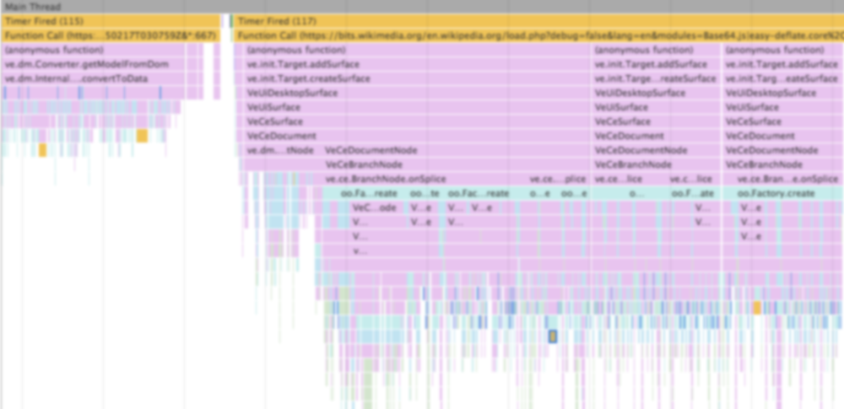
Flame charts
Notes:
Time: 20 sec It’s just the visualization of stack data over a period of time. Data could be related to your application’s javascript processing, netowking process, gpu processing etc. Let me take you to the demo. where we can see how can we use flame chart and how it can help us to analyze what is happening on website.

Slide 6
Memory Profiling
Notes:
Time: 30 sec.
As many of you might already know that we can take memory snapshots in multiple ways and each technique has it’s own unique insights.
Heap snapshot.
Allocation Instrumentation on Timeline.

Slide 7

Quick Demo….. Yippie ☺
Notes:
Time: 3 min

Slide 8
Chrome Tracing
Notes:
Time: 20 sec
Chrome tracing

Slide 9
Working Set
Notes:
Total memory takes by the whole process. Which includes Js heap, cache , v8 memory etc
'blink.user_timing',
'v8',
'disabled-by-default-v8.runtime_stats',
'disabled-by-default-v8.gc_stats',
'disabled-by-default-memory-infra'

Slide 10
Demo….. Yippie ☺
Notes:
Time: 3 min

Slide 11
Performance @ Scale (Abstract)
Notes:
Time: 10 sec
We will see in the coming slides how we manage performance at scale in our Teams application.

Slide 12

Perf Gates as our guards
Developers
PR Gates
Perf Azure Pool
Container 1
Pull Requests
Scenario 1
Build References
Container 2
PR Builders
Scenario N
Container N
Azure Stores
Perf Dashboards
Notes:
Time: 1 min
We don’t trust manual measuring of things. We have setup our automated guards to take care of things. As soon as a developer create a pull request we should perf gates in multiple containers for the build and observe the metrics accordingly.
PLT: Page Load Time
ALT: Application Launch Time
Scenario Specific checks.

Slide 13
Perf Gates as our guards
Developers
PR Gates
Perf Azure Pool
Container 1
Pull Requests
Scenario 1
Build References
Container 2
PR Builders
Scenario N
Container N
Azure Stores
Perf Dashboards
Notes:
Time: 1 min
We don’t trust manual measuring of things. We have setup our automated guards to take care of things. As soon as a developer create a pull request we should perf gates in multiple containers for the build and observe the metrics accordingly.
PLT: Page Load Time
ALT: Application Launch Time
Scenario Specific checks.

Slide 14
Perf Gates as our guards
Developers
PR Gates
Perf Azure Pool
Container 1
Pull Requests
Scenario 1
Build References
Container 2
PR Builders
Scenario N
Container N
Azure Stores
Perf Dashboards
Notes:
Time: 1 min
We don’t trust manual measuring of things. We have setup our automated guards to take care of things. As soon as a developer create a pull request we should perf gates in multiple containers for the build and observe the metrics accordingly.
PLT: Page Load Time
ALT: Application Launch Time
Scenario Specific checks.

Slide 15
Perf Gates as our guards
Developers
PR Gates
Perf Azure Pool
Container 1
Pull Requests
Scenario 1
Build References
Container 2
PR Builders
Scenario N
Container N
Azure Stores
Perf Dashboards
Notes:
Time: 1 min
We don’t trust manual measuring of things. We have setup our automated guards to take care of things. As soon as a developer create a pull request we should perf gates in multiple containers for the build and observe the metrics accordingly.
PLT: Page Load Time
ALT: Application Launch Time
Scenario Specific checks.

Slide 16
Perf Gates as our guards
Developers
PR Gates
Perf Azure Pool
Container 1
Pull Requests
Scenario 1
Build References
Container 2
PR Builders
Scenario N
Container N
PASS / FAIL
Azure Stores
Perf Dashboards
Notes:
Time: 1 min
We don’t trust manual measuring of things. We have setup our automated guards to take care of things. As soon as a developer create a pull request we should perf gates in multiple containers for the build and observe the metrics accordingly.
PLT: Page Load Time
ALT: Application Launch Time
Scenario Specific checks.

Slide 17
Client Metrics collection pipeline
Persistent Store (Cold Storage)
Dashboards
Client Browser
Scenario Collector SDK
Specific highly performant store (warm storage last 6 months)
Data Collector Service
IndexDB
Monitoring /
Alerting System
WebWorkers
Real time in memory store (hot storage last 3-5 days)
Notes:
Time: 2 min
Scenario Markers
IndexDB
Webworkers 30 sec.

Slide 18
Demo: https://github.com/rachitGulati/reactfoo-2018
References:
https://developers.google.com/web/tools/chrome-devtools/evaluate-performance/reference
https://chromium.googlesource.com/chromium/src/+/master/docs/memory-infra
https://docs.google.com/presentation/d/1ePz0Xbrxm0pyuDsgJrT-_y_VZqW6Ny4Cs64fvXobQIA/edit?usp=drive_web

Slide 19

Bob do you have any questions ?
Let me ask my friends in Q&A☺

Slide 20
Any queries free feel to tweet me @squiroid Thank you all :) PS: This is my first talk I hope I didn’t screw it up :P

